Slide 1
Weight Initialization

Slide 2
Weight
Initialization
Weight Initialization

Slide 3
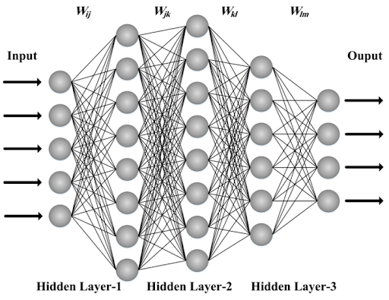
WI

Slide 4
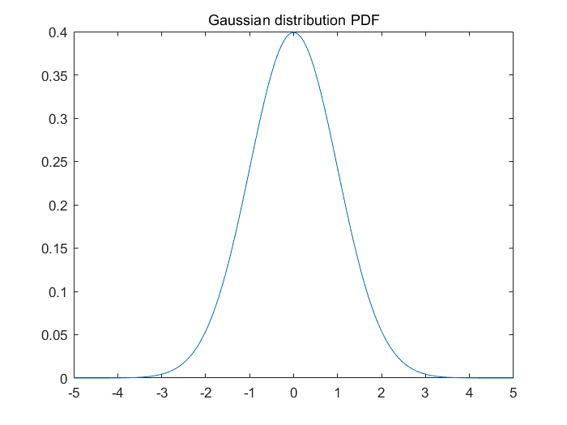
WI
Random function => Gaussian Distribution
The initial Weight
Gaussian Distribution

Slide 5
WI
The initial Sample
Gaussian Distribution

Slide 6
WI
Ex) 1-layer num of node is 500
Num of Sample is 500
500X1 Matrix
500X500 Matrix
Calculation
Matrix Calculation

Slide 7
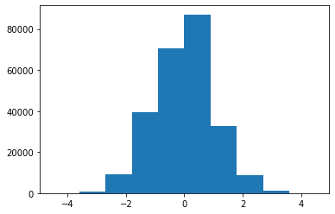
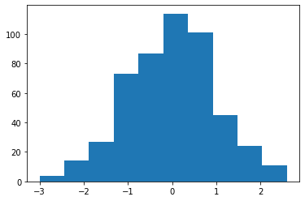
WI
weight
Sample

Slide 8
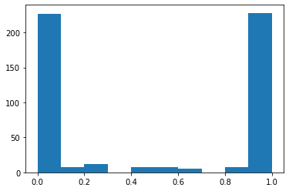
WI
Sigmoid function

Slide 9
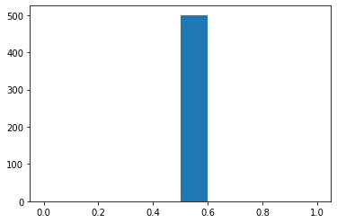
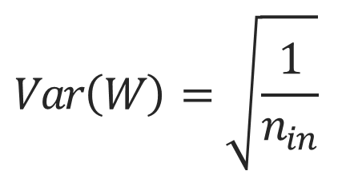
WI
LeCun
method 1
$$Var\left(W\right)=\sqrt{\frac{1}{n_{in}}}$$

Slide 10
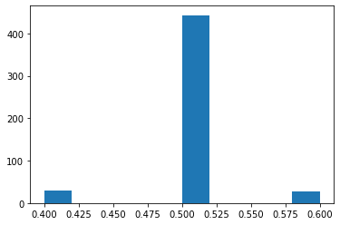
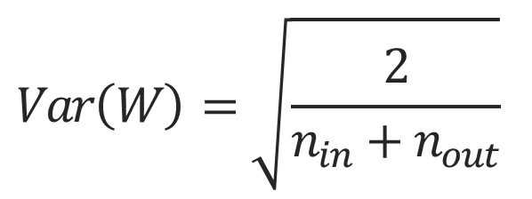
WI
Xavier
method 2
$$Var\left(W\right)=\sqrt{\frac{2}{n_{in}+n_{out}}}$$

Slide 11
WI
Paper
Understainding the difficulty of training deep feedforward neural networks

Slide 12
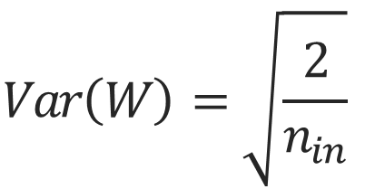
WI
ReLU Weigt initialization
He Initialization
$$Var\left(W\right)=\sqrt{\frac{2}{n_{in}}}$$

Slide 13
Bias
Initialization
Bias => 0
ReLU => Bias 0.01

Slide 14
감사합니다
THANK YOU

